Slide 1
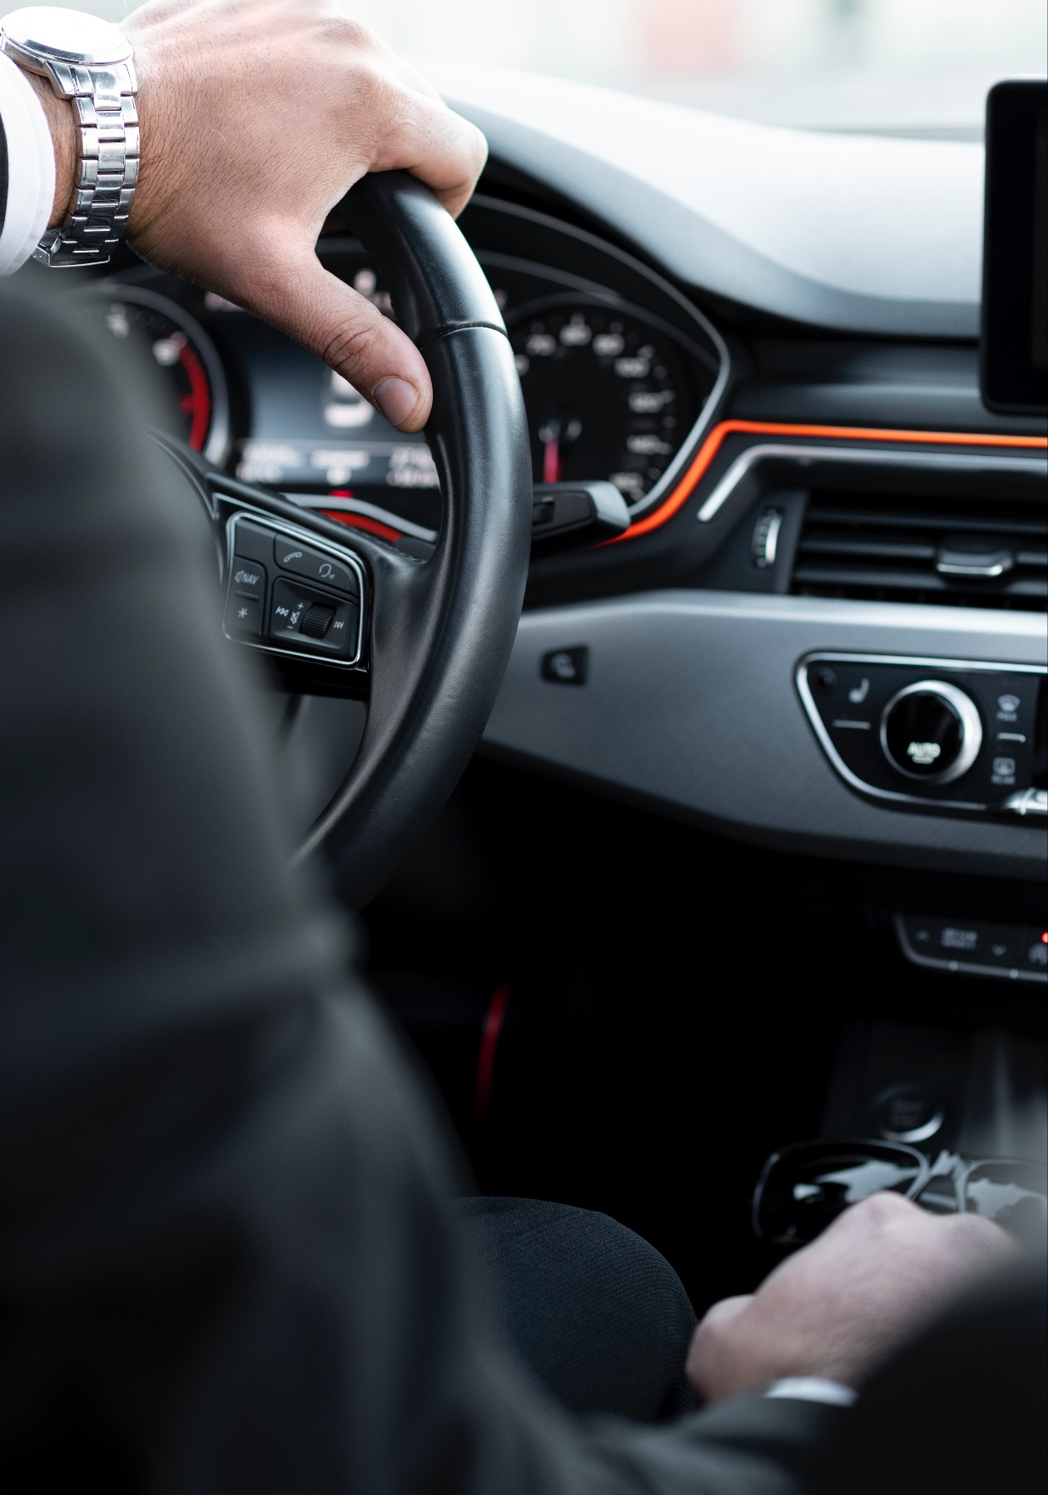
Fraud detection in car insurance claims
MISTI GTL - AI Uruguay 2026
Florencia Barrios, Maria Ines Martinote, Florencia Lucas

Slide 2
Table of contents
01
Problem & objective
02
Data
03
Models & Methods
04
Evaluation & results

Slide 3
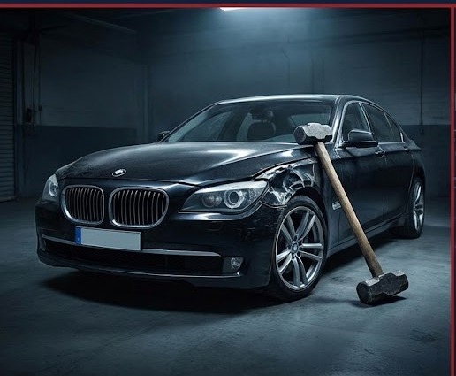
Real-World Scenarios
1. Professional Fraud
Destroying luxury cars with hammers to collect high-value payouts.
2. Staged Accidents
Forcing rear-end crashes to blame innocent drivers.
3. Opportunistic Fraud
Buying a policy after an accident to claim pre-existing damage.
Notes:
Instead of looking at rows in a database, we look at real behaviors. From organized rings smashing luxury cars with hammers to 'Inception Fraud' where someone buys insurance after a crash. Our model is designed to catch these specific patterns.

Slide 4
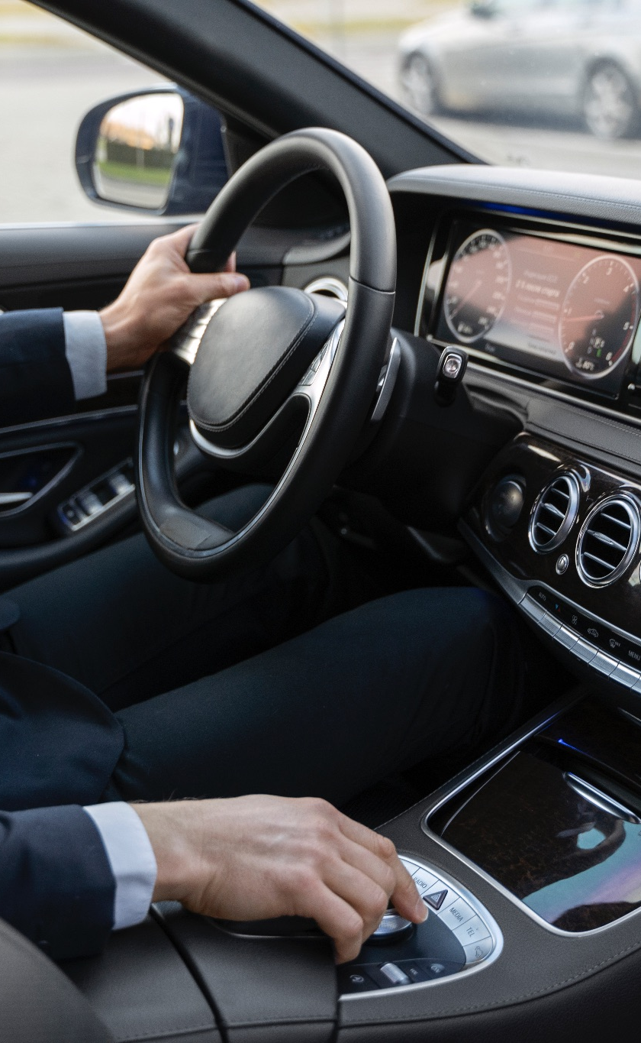

Fraud = Invisible Profit Loss
The Problem
For insurance companies manual fraud detection is slow, expensive, and prone to human error.
The Solution
A binary classification model trained on historical claim data.
How?
Input: historical claims labeled.
Output: A binary prediction (fraud vs. legitimate) to prioritize high-risk investigations.
Notes:
ABT: Car insurance fraud is a big problem because companies lose money on fake claims, AND this hurts their business results. BUT detecting fraud manually is slow and very expensive. THEREFORE, we are using historical data to build a model that predicts if a claim is real or fraudulent.

Slide 5
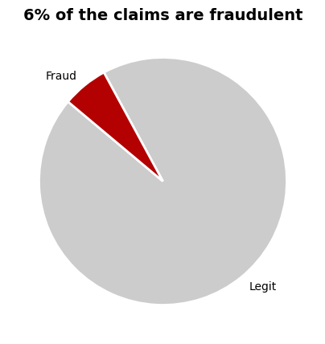
Data Overview
Source: Kaggle "Fraud Oracle" dataset
Volume: 15,420 rows and 33 features (24 categorical variables)
Target: FraudFound_P (Binary: 0 or 1)
Limitation: Historical data (1994-1996) with no specific claim timestamps
Key Features:
Policy (‘BasePolicy’, ‘Deductible’)
Vehicle & Driver: ‘VehiclePrice’, ‘VehicleCategory’, ‘AgeOfPolicyHolder’, DriverRating.
Incident Details: Fault, AccidentArea, PoliceReportFiled.

Slide 6

Preprocessing
Grouping categories with <100 cases
One hot encoding
Categorical features conversion to numerical
2. Cleaning
4. Encoding
1. Raw Data
3. Feature Engineering
5. Final Dataset
Train and test split
SMOTE to balance the dataset
Days to report
Is_Policy_Holder_Driving
Weekend
Luxury
Notes:
"Hi everyone. Let’s talk about Data Processing.
First, we cleaned the data. We confirmed there were no missing values and no duplicates, so we started with a clean base.
Then, we improved the data with Feature Engineering: We grouped small categories together to reduce noise. We created new variables, like 'Days to Report'—which measures the delay between the accident and the claim. We also created dummy variables for 'Weekends' and a specific 'Luxury' tag to identify brands like BMW, Jaguar, Mercedes, Porsche, and Ferrari.
To prepare the data, we applied One Hot Encoding to 'Vehicle Category' and turned all other text into numbers. Then, we did a standard 80-20 Train-Test split.
Finally, and most importantly, we applied SMOTE (synthetic minority over sampling technique) to balance the dataset. This generated synthetic fraud cases in our training set, ensuring the model doesn't ignore the minority class."

Slide 7
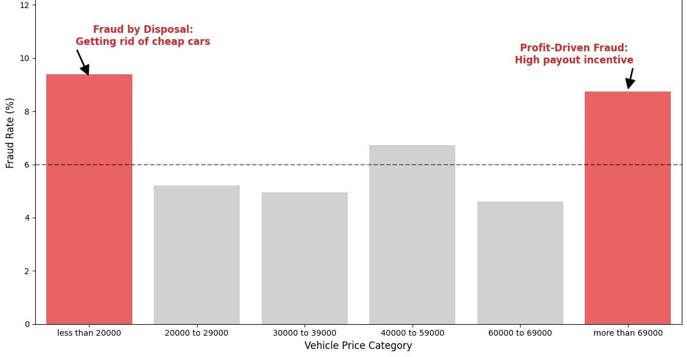
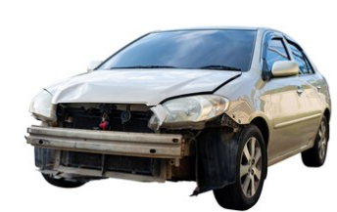
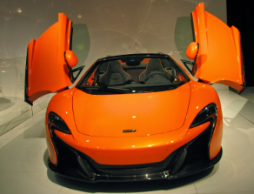
We refuted the myth that 'higher value means less crime”
Notes:
It’s interesting: Fraud happens at both extremes.First, Cheap Cars. The motive is money. These cars are old and hard to sell. So, owners fake accidents just to sell the car to the insurance company. Second, Luxury Cars. The motive is Inflation. Repairs are very expensive, so owners lie about the damage to make a profit.

Slide 8
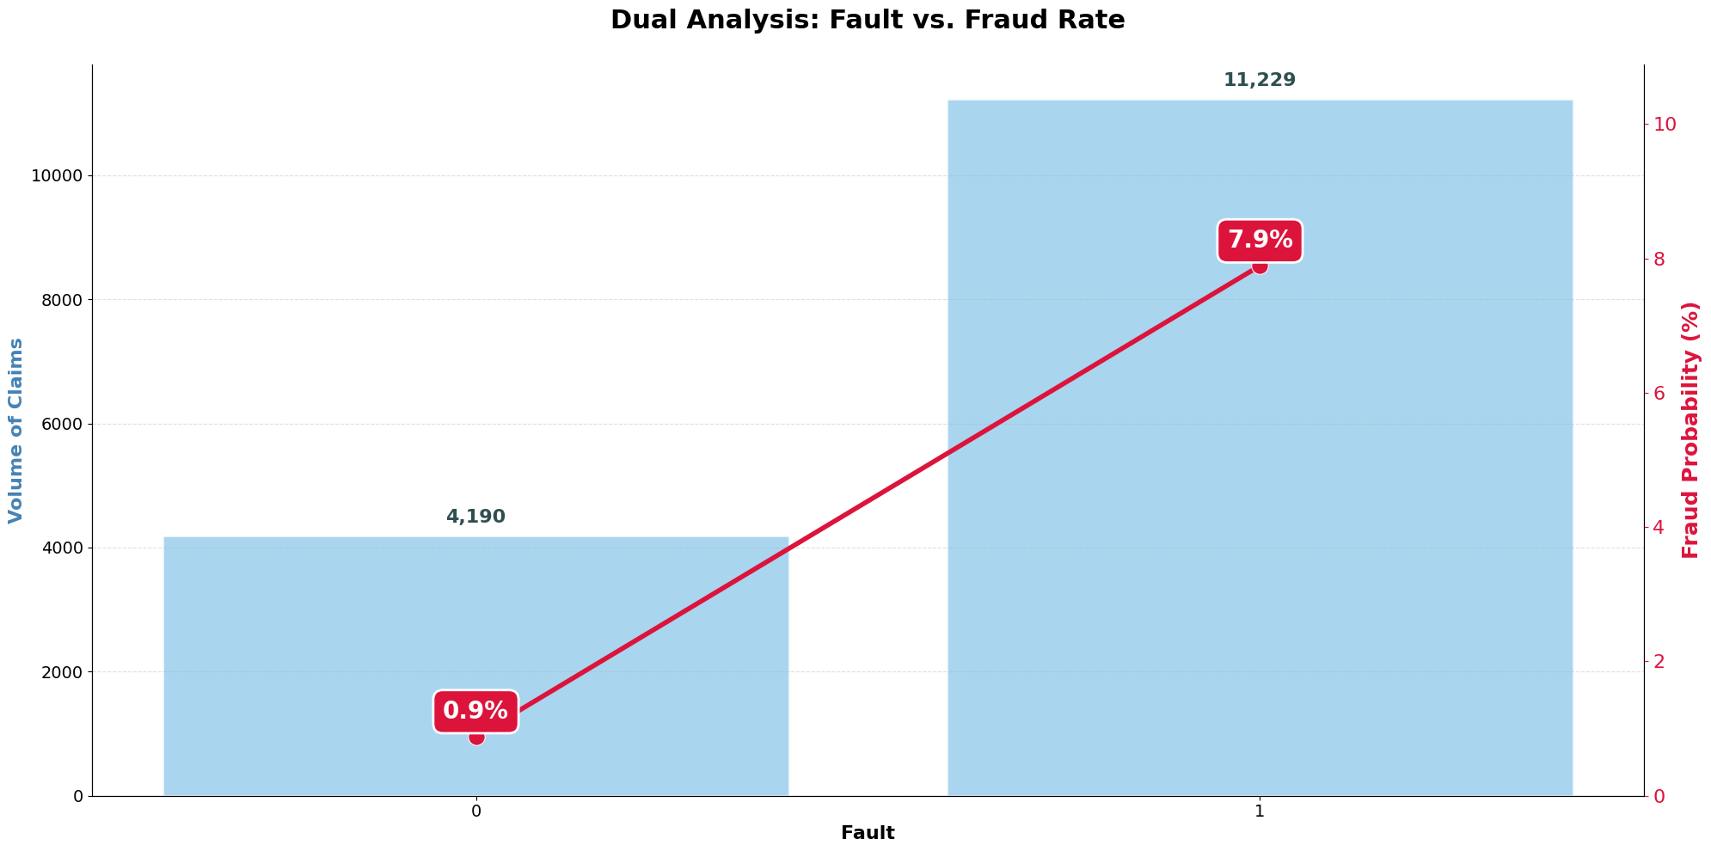

Higher Fraud Risk when Policyholder is at Fault
If you cause the damage, you have a financial motive to lie that victims simply don't have
Notes:
As you can see in this chart, being 'At Fault' is a major red flag. People responsible for the accident are much more likely to commit fraud. It makes sense: if you cause the damage, you have a financial motive to lie that victims simply don't have

Slide 9

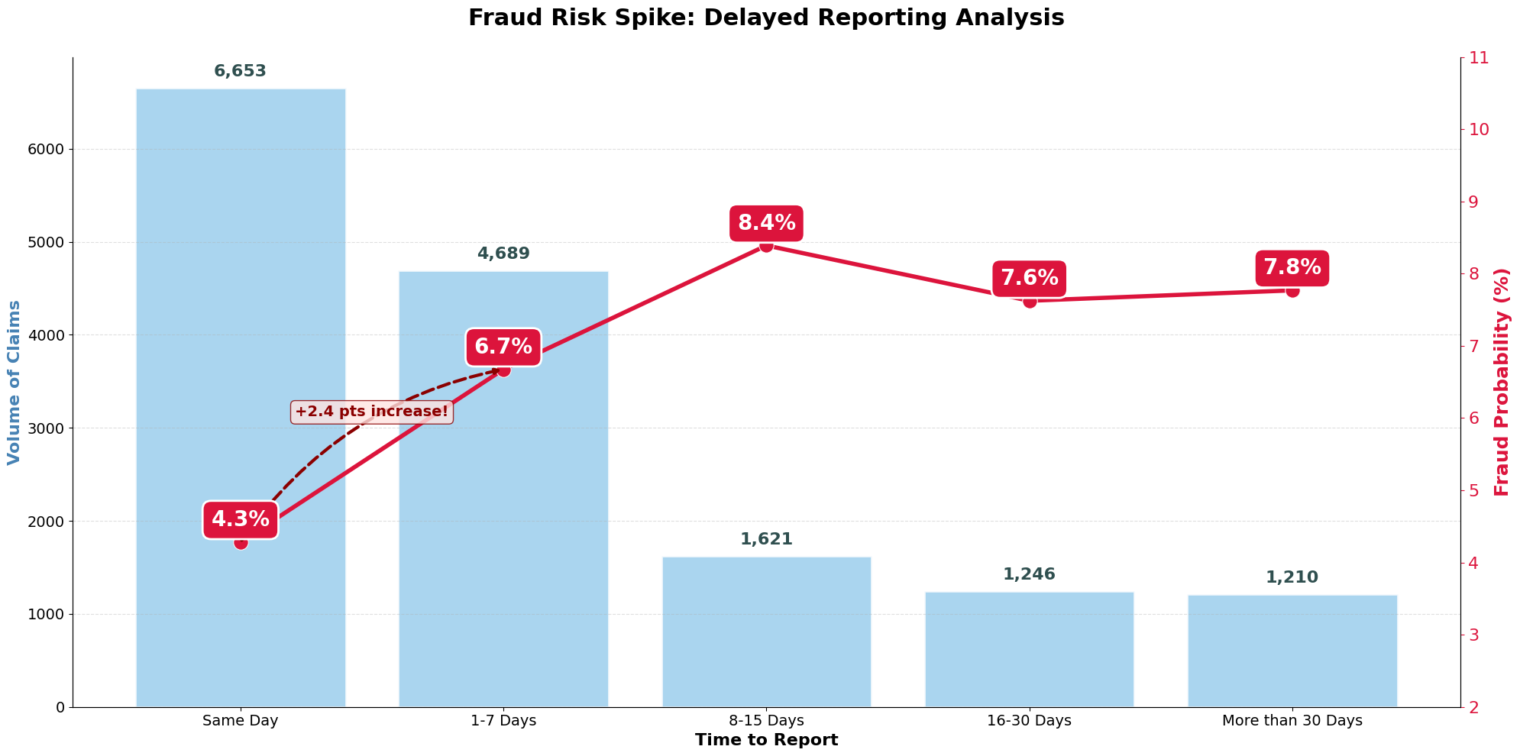
Time acts as a lie detector
Honest people don't wait two weeks. This delay is a clear sign that someone is planning a story.
Notes:
Think about it: If you have a real accident, you report it immediately. You want it fixed today. That is why the blue bar at Day 0 is so high.
But when people wait, the risk explodes. If the report is delayed by 8 to 15 days, the chance of fraud actually doubles. Honest people don't wait two weeks. This delay is a clear sign that someone is planning a story.

Slide 10
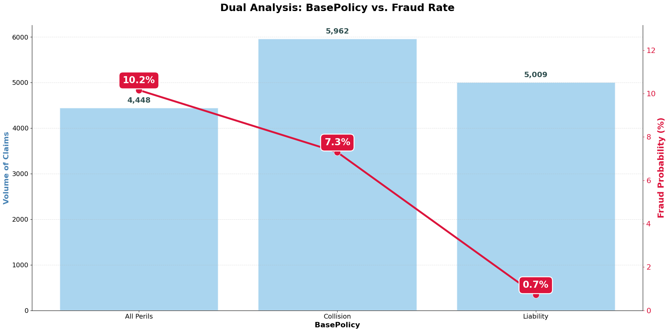
The Risk Gap in Base Coverage
Since All Perils it covers everything, it is the perfect target for fraud.
Notes:
Let’s clarify the Policy Types to understand the risk.
First, Liability: This only covers damage you cause to other people.
Second, Collision: This covers your car, but only if you crash.
And finally, All Perils: cover liability, colission and total cause incluiding thef or fire
Since 'All Perils' it covers everything, it is the perfect target for fraud.

Slide 11

Key Hyperparameters
Iterations (500): Set to ensure full model convergence while maintaining high computational efficiency.
Loss Function (Logloss): Optimized for binary classification to provide precise probability estimates for fraud.
Evaluation Metric (AUC): Used to maximize the model's ability to rank high-risk claims correctly.
Auto Class Weights (Balanced): Automatically penalizes misclassifying the minority class.

Slide 12
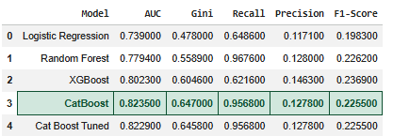
Models Selection & Results
Logistic Regression: Simple but limited. Failed to capture complex, non-linear fraud patterns.

Slide 13
Models Selection & Results
Logistic Regression: Simple but limited. Failed to capture complex, non-linear fraud patterns.
Random Forest: Improved complexity but there are better algorithms.

Slide 14
Models Selection & Results
Logistic Regression: Simple but limited. Failed to capture complex, non-linear fraud patterns.
Random Forest: Improved complexity but there are better algorithms.
XGBoost: Powerful boosting, but less efficient at handling high-cardinality categorical data.

Slide 15
Models Selection & Results
Logistic Regression: Simple but limited. Failed to capture complex, non-linear fraud patterns.
Random Forest: Improved complexity but there are better algorithms.
XGBoost: Powerful boosting, but less efficient at handling high-cardinality categorical data.
CatBoost: Best handling of categorical features and superior stability in ranking fraudulent risk.

Slide 16
Models Selection & Results
Logistic Regression: Simple but limited. Failed to capture complex, non-linear fraud patterns.
Random Forest: Improved complexity but there are better algorithms.
XGBoost: Powerful boosting, but less efficient at handling high-cardinality categorical data.
CatBoost: Best handling of categorical features and superior stability in ranking fraudulent risk.
CatBoost Tuned: Despite applying a rigorous 2-phase optimization metrics remained stable.

Slide 17
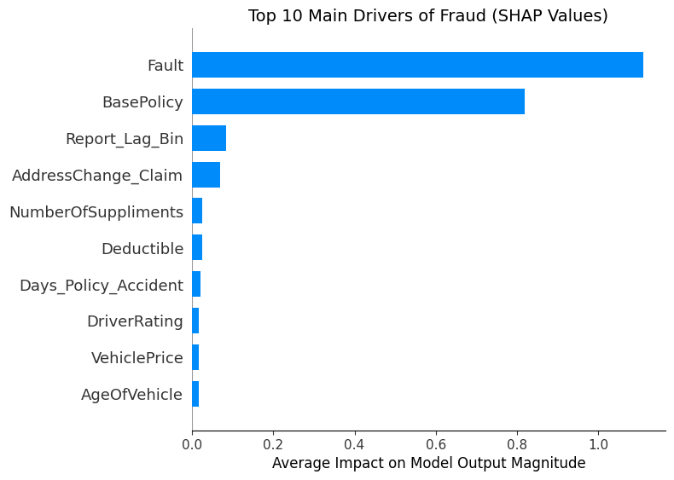
Decoding the Main Drivers of Insurance Fraud

Slide 18
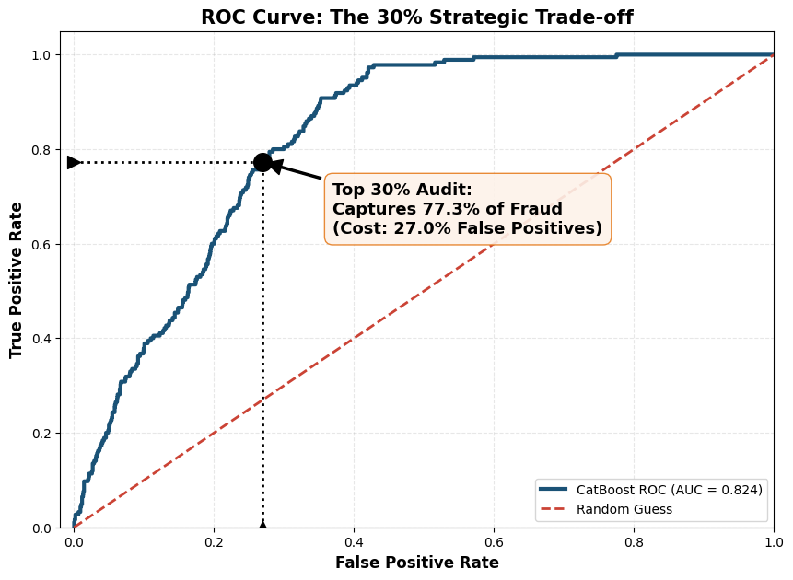
Capturing 77% of Fraud with 30% Operational

Slide 19
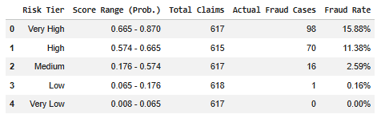
Project Impact & Key Takeaways
1. Business Value
Operational Efficiency
Customer Experience (Fast-Tracking)
2. Challenges & Limitations
Unbalanced data requires special preprocessing/ hyperparameters
This model requires continuous retraining to detect emerging fraud tactics
3. Future Work
Test the model on more recent data
External data integration

Slide 20

Thank you!

